Slide 1
ADVANCED SOLAR TRACKING SYSTEM

Slide 2
Objective:
Model the sun's movement using a mathematical equation
Model servo motor to physically rotate the panel
Include real world effects like temperature and cloud cover
Compare energy output of tracked panel vs fixed panel
Prove that solar tracking increases energy by at least 35%
2

Slide 3
Theory:
1. Solar Tracking System
A solar tracking system is a mechanism that continuously rotates a solar panel so that it remains facing the Sun throughout the day. By maintaining the optimum angle of incidence, the panel receives maximum sunlight and generates more electrical energy than a fixed solar panel.
Sun Position Modeling
In this project, the Sun's movement is represented using a sine wave in MATLAB Simulink. The sine wave produces a smooth change in the sun angle from sunrise to sunset and acts as the reference signal for the controller.
3

Slide 4
Environmental Effects:
1. Solar Irradiance
2. Temperature Effect
3. Cloud Disturbance
Solar irradiance is the amount of sunlight reaching the surface of the solar panel.
When irradiance increases, the solar panel absorbs more heat, causing its temperature to rise.
In practical conditions, clouds randomly block sunlight, causing sudden variations in solar intensity. This is simulated using a Band-Limited White Noise block, producing fluctuations similar to real changing weather.
Measured in W/m²
4

Slide 5
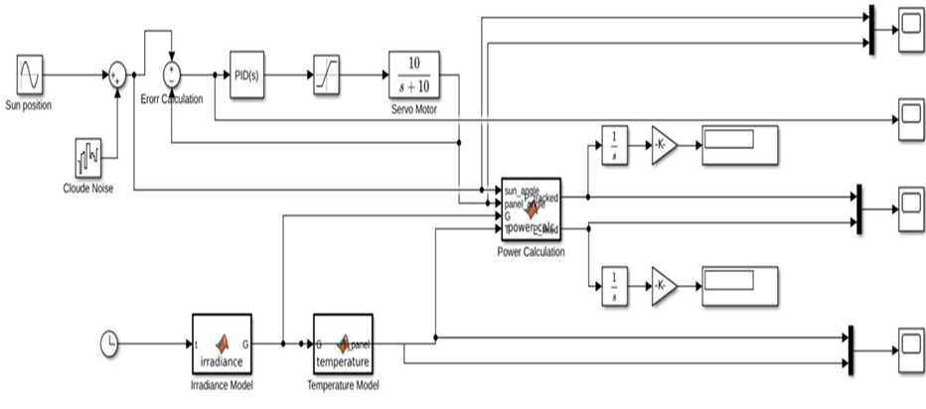
Simulink Block Diagram:
5

Slide 6
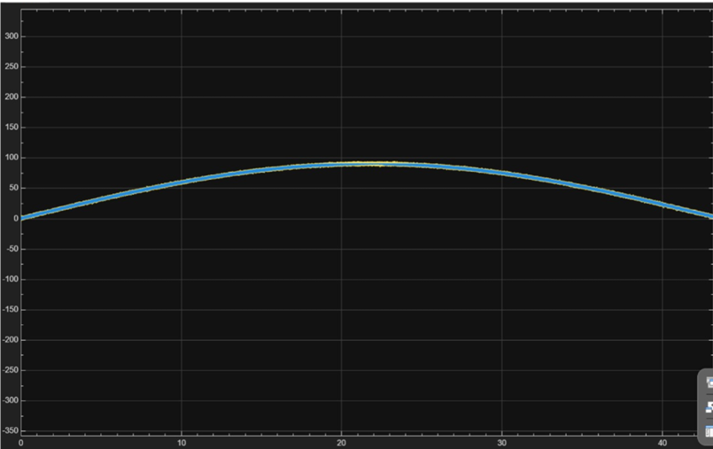
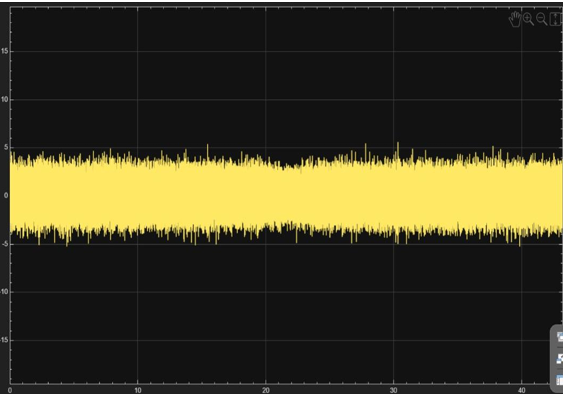
Output:
1. Sun Angle vs Panel Angle
2. Tracking Error Signal
The panel angle closely follows the sun angle throughout the simulation.
This confirms accurate solar tracking by the PID controller.
The error between the sun angle and panel angle remains very small.
Small fluctuations are caused by simulated cloud disturbances, demonstrating stable and accurate PID control.
6

Slide 7
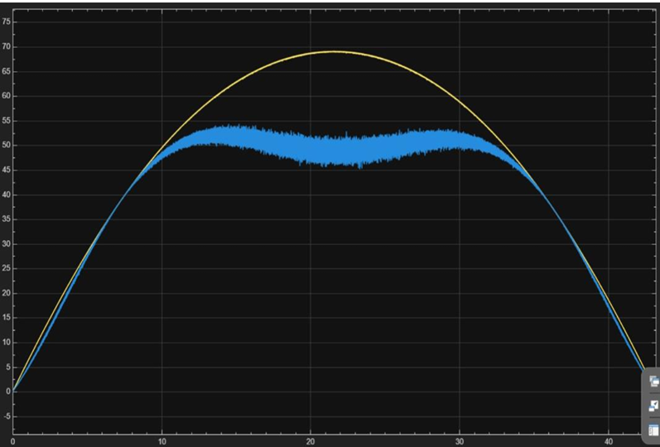
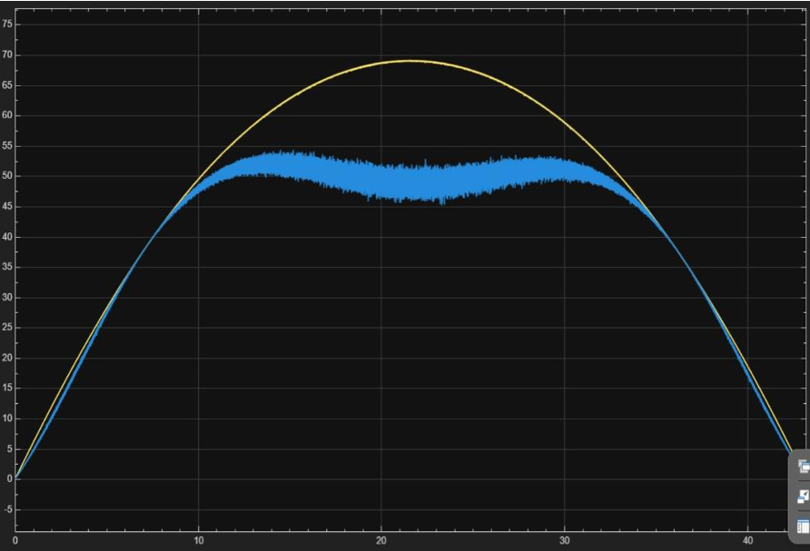
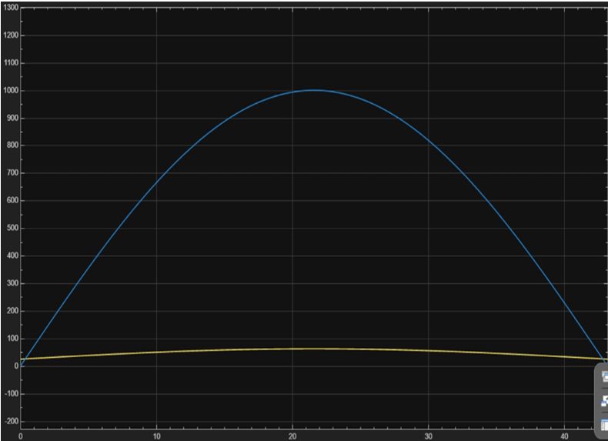
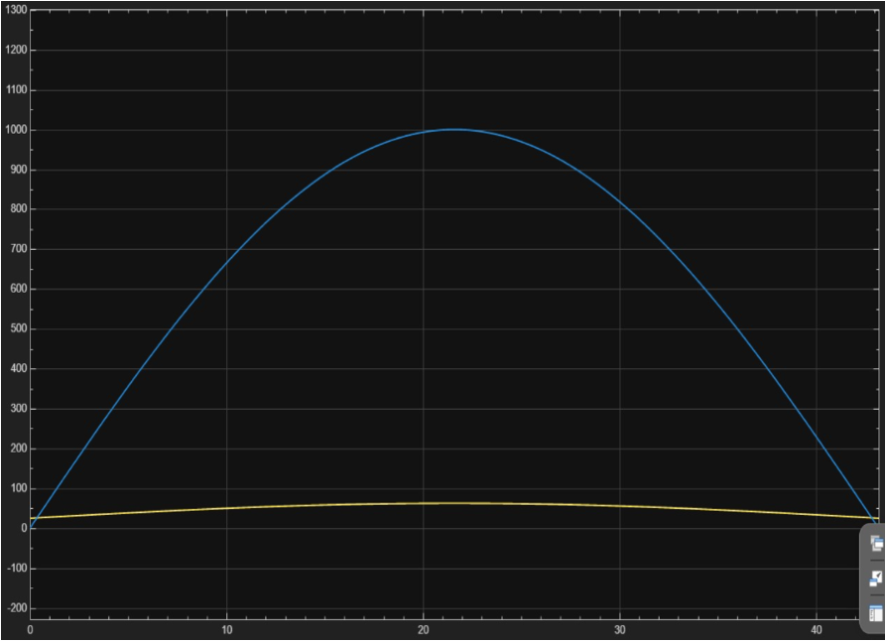
3. Power Output Comparison
4. Irradiance and Panel Temperature
The tracked solar panel generates higher power than the fixed solar panel.
Maximum power occurs when the panel is properly aligned with the Sun; the fixed panel produces comparatively lower power throughout the day.
Solar irradiance increases from morning to noon and decreases toward evening.
Panel temperature follows a similar trend since higher irradiance causes more heating, slightly reducing efficiency.
7

